Slide 1
Applied Artificial Intelligence
AI4007
(Artificial Neural Network-IV)
Lecture No. 14
Instructor: Dr. Kashif Zafar
March 28, 2024
National University of Computer and Emerging Sciences, Lahore

Slide 2
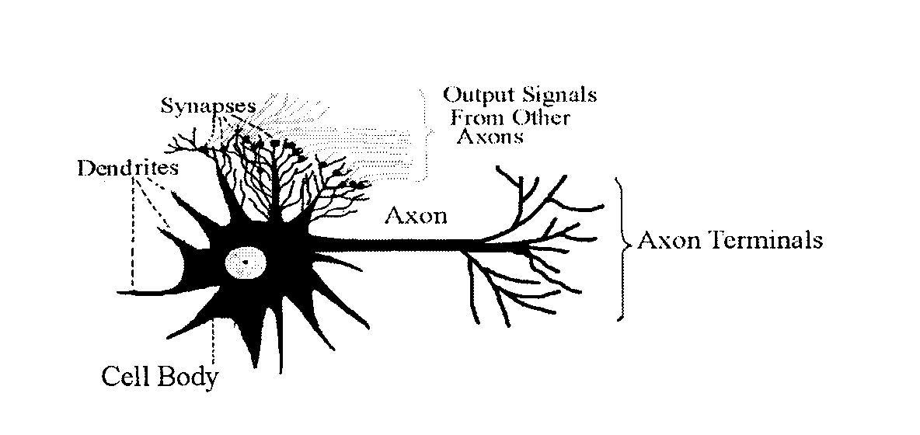
NEURAL NETWORKS
Biological Neuron
About 100 billion neuron in the human brain

Slide 3
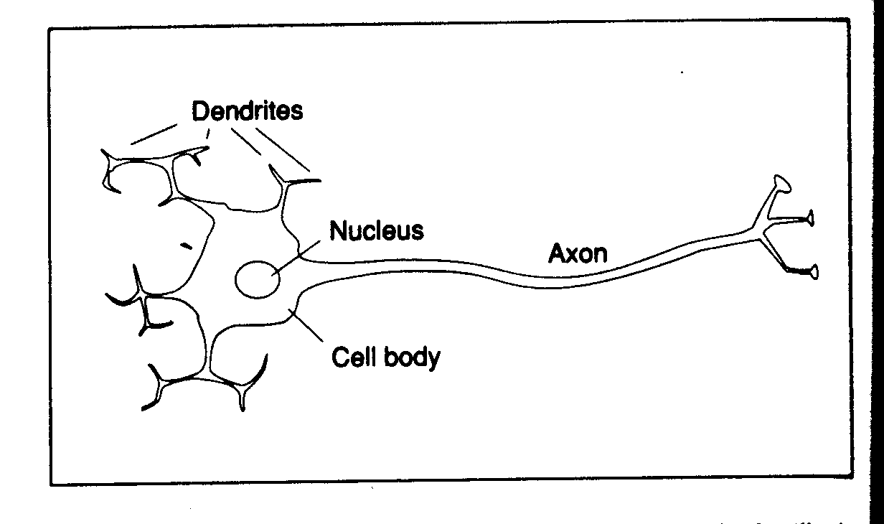
NEURAL NETWORKS
Biological Neuron

Slide 4
NEURAL NETWORKS
Biological Neuron
The main body of the cell collects the incoming signals from the other neurons through its dendrites
The incoming signals are constantly being summed in the cell body
If the result of the summation crosses as certain threshold, the cell body emits a signal of its own (called firing of the neuron)
This signal passes through the neuron’s axon, from where the dendrites of other neurons pick it up

Slide 5
NEURAL NETWORKS
Biological Neuron
There are 1,000 to 10,000 dendrites in each neuron (few millimeters long)
There is only one axon (several centimeters long)
The connection between dendrites and axon is electrochemical and it is called synapses
The synapses modify the signal while passing it on to dendrites
The human learning is stored in these synapses, and the connection of neurons with other neurons

Slide 6
NEURAL NETWORKS
Biological Neuron
The human learning is stored in these synapses, and the connection of neurons with other neurons
If stimulus at a dendrite causes the neuron to fire, then the connection between that dendrite and axon is strengthened
If the arrival of stimulus does not cause the neuron to fire, the connection weakens over time

Slide 7
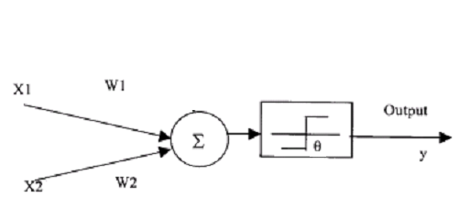
NEURAL NETWORKS
Artificial Neuron Model

Slide 8
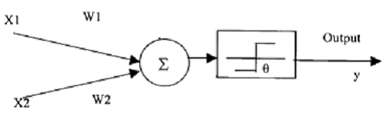
NEURAL NETWORKS
Artificial Neuron Model
Implementation of AND
function
Let W₁ = W₂ = 1
X₁ X₂ X₁W₁ + X₂W₂ Y
0 0 0 0
0 1 1 0
1 0 1 0
1 2 1
If we make θ = 2 (or any value >1 but <=2), we will get correct results with a unit step activation function

Slide 9
NEURAL NETWORKS
Artificial Neuron Model
If we place the 4 points in a two coordinate system (X1 and X2), we have drawn a line from (2, 0) to (0, 2) in the resulting plane
Any new data falling on the left side of the line will give an output of zero and the data on the right side of the line will be classified as one

Slide 10
NEURAL NETWORKS
Artificial Neuron Model
Implementation of OR
function
Let W₁ = W₂ = 1
X₁ X₂ X₁W₁ + X₂W₂ Y
0 0 0 0
0 1 1 1
1 0 1 1
1 2 1
If we make θ = 1 (or any value >0 but <=1), we will get correct results with a unit step activation function

Slide 11
NEURAL NETWORKS
Artificial Neuron Model
If we place the 4 points in a two coordinate system (X1 and X2), we have drawn a line from (1, 0) to (0, 1) in the resulting plane
Any new data falling on the left side of the line will give an output of zero and the data on the right side of the line will be classified as one

Slide 12
Perceptron Learning Rule
Show the mathematical working of Artificial Neural Network by taking the case in figure below. First two columns are the input values for X1 and X2 and the third column is the desired output.
Learning rate = 0.2
Threshold = 0.5
Actual output = W1X1+W2X2
Next weight adjustment = Wn+ΔWn
Change in weight = ΔWn = learning rate * (desired output- actual output) * Xn
In Figure. First two columns are input vectors x1 and x2 and last column is the desired output y.
Show the complete iterations for acquiring the desired output?
x1 x2 w1 w2 d y Δ w1 Δ w2
0 | 0 | 0
0 | 1 | 0
1 | 0 | 1
1 | 1 | 1

Slide 13
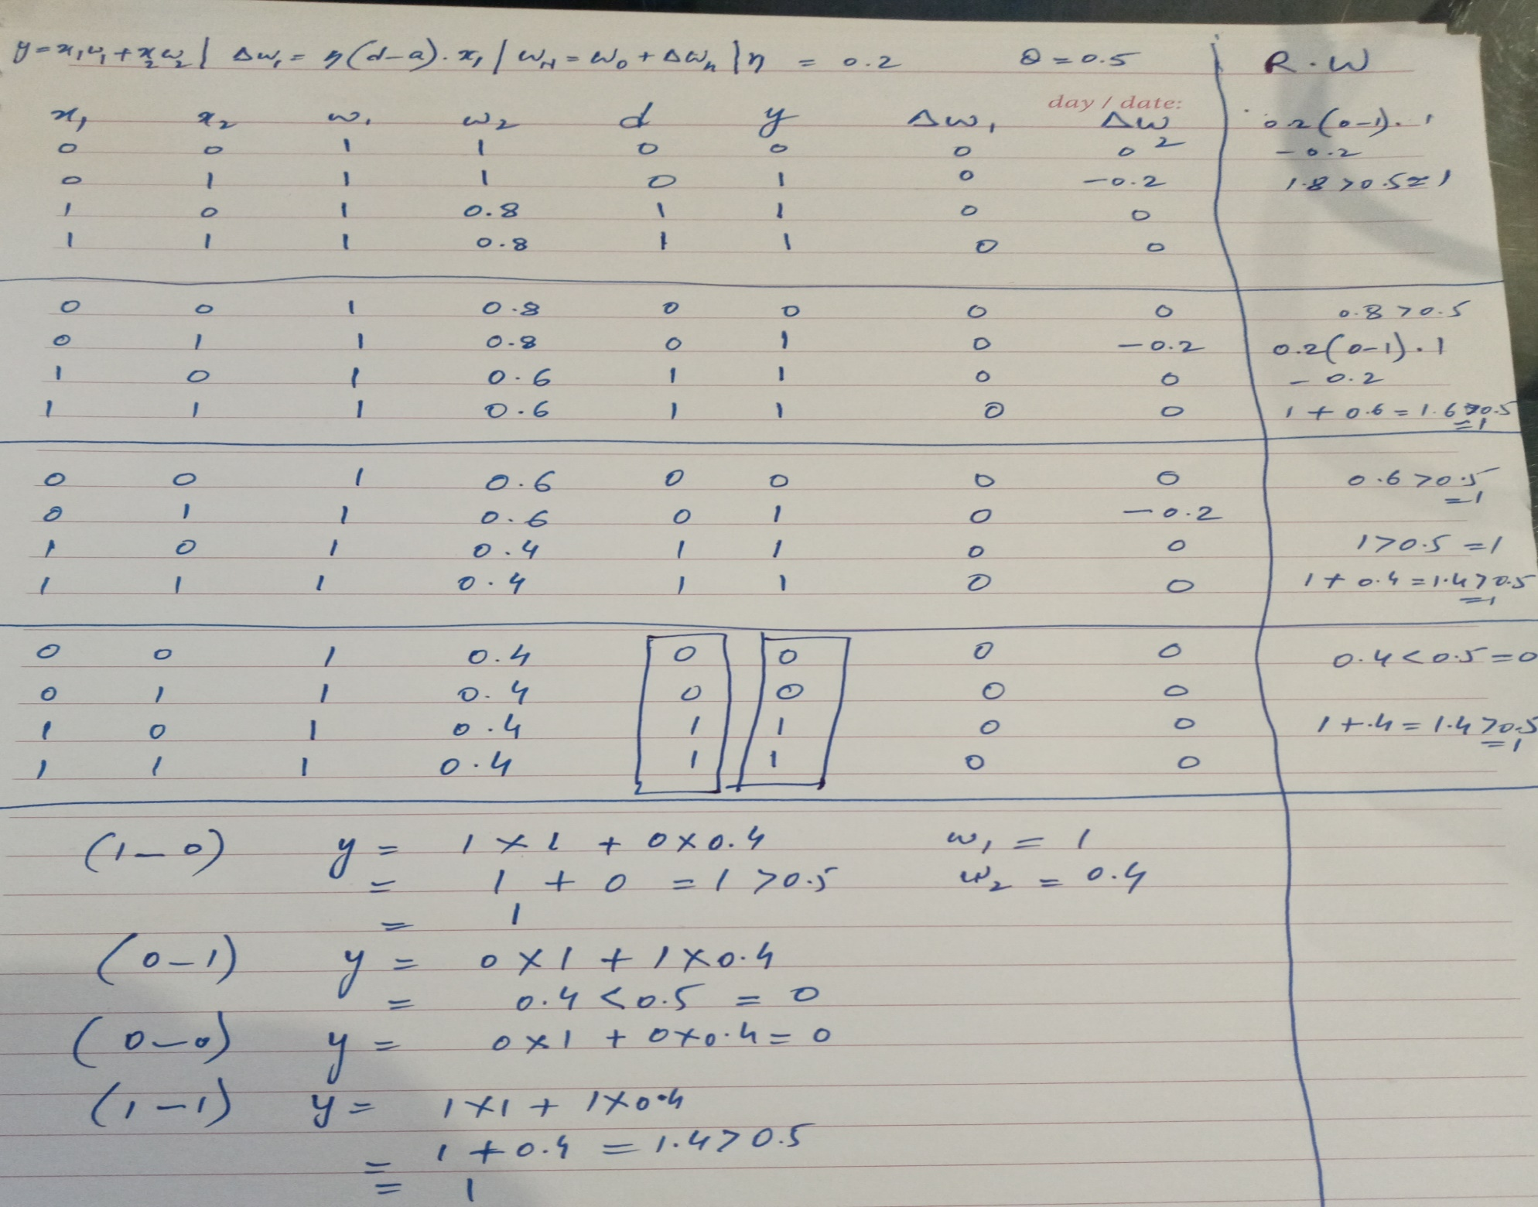

Slide 14
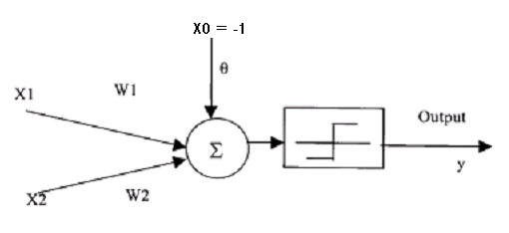
NEURAL NETWORKS
Artificial Neuron Model
If we want to utilize a unit step function centered at zero for both AND and OR neurons, we can incorporate another input X0 constantly set at –1
The weight W0 corresponding to this input would be the θ, calculated previously

Slide 15
ARTIFICIAL NEURON
Artificial Neuron Model
AND function
W₁ = W₂ = 1
We have calculated θ = 1.5 for this problem, so W₀ = θ = 1.5
X₁ X₂ X₁W₁ + X₂W₂ + (-1)W₀ Y
0 0 0 – 1.5 = -1.5 F With bias
0 1 1 – 1.5 = -0.5 F a unit step
1 0 1 – 1.5 = -0.5 F function
1 2 – 1.5 = 0.5 T centered at
0 is used

Slide 16
NEURAL NETWORKS
Setting of weights (Training)
X₁ X₂ Y
1.0 1.0 1
9.4 6.4 -1
2.5 2.1 1
8.0 7.7 -1
0.5 2.2 1
7.9 8.4 -1
7.0 7.0 -1
2.8 0.8 1
1.2 3.0 1
7.8 6.1 -1

Slide 17
NEURAL NETWORKS
Training of weights
Supervised training: the classes of training samples are known
Random initialization of weights
(threshold or bias is considered as a weight and its input is fixed at 1)

Slide 18
NEURAL NETWORKS
Training of weights: Algorithm
For each input, calculate the output with the current weights
The error will be equal to y_{desired} – f(∑x_{i}w_{i})
How to reduce this error?
Input is fixed
We have to change weights
Which weight to change?
Since we don’t know which weight is contributing how much to the error, hence we change all weights

Slide 19
NEURAL NETWORKS
Training of weights: Algorithm
How much will be the change in a weight?
The change in each connection weight has to be proportional to the error and the magnitude of its input
(we assume that each weight is contributing to the error a value proportional to its input)
Change each weight by δ w_{i} = η(y – f(∑x_{i}w_{i}))x_{i}
The learning rate η is fixed at a small value, so that we may not only learn the current data sample, but also the retain the previous learning

Slide 20
NEURAL NETWORKS
Training of weights: Algorithm
Iterate repeatedly over the whole data set.
Stop when the combined error of all the inputs is below a certain threshold

Slide 21
NEURAL NETWORKS
Linearly Separable Problems
If the data can be correctly divided into two categories by a line or hyper-plane

Slide 22

NEURAL NETWORKS
Non Linear Problems
If the data cannot be correctly separated by a single line or plane, then it is not linearly separable. A single layer of neurons cannot classify the input patterns that are not linearly separable; e.g. exclusive OR problem

Slide 23
NEURAL NETWORKS
Non Linear Problems
For such problems we need two or more layers of neurons
-1
0.5
1
-1
x₁
-1
-1
1
-0.5
x₂
1
-1
-1

Slide 24
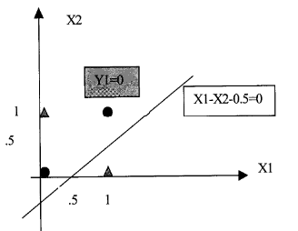
NEURAL NETWORKS
Non Linear Problems
The first neuron’s output is
Point (0, 0) => Sum = -0.5 and Y1 = 0
Point (0, 1) => Sum = -1.5 and Y1 = 0
Point (1, 0) => Sum = 0.5 and Y1 = 1
Point (1, 1) => Sum = -0.5 and Y1 = 0
It places a line

Slide 25
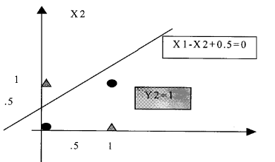
NEURAL NETWORKS
Non Linear Problems
The second neuron’s output is
Point (0, 0) => Sum = 0.5 and Y2 = 1
Point (0, 1) => Sum = -0.5 and Y2 = 0
Point (1, 0) => Sum = 1.5 and Y2 = 1
Point (1, 1) => Sum = 0.5 and Y2 = 1
It places a line

Slide 26
NEURAL NETWORKS
The input sum for the neuron of the 2nd layer = Y1 – Y2 + 1
For point (0,1) Y1 = 0, Y2 = 0, Sum = 1, Y3 = 0
For point (1,0) Y1 = 1, Y2 = 1, Sum = 1, Y3 = 0
For point (0,0) Y1 = 0, Y2 = 1, Sum = 0, Y3 = 1
For point (1,1) Y1 = 0, Y2 = 1, Sum = 0, Y3 = 1
Thus the neuron of the 2nd layer separates the data correctly

Slide 27
NEURAL NETWORKS
The first layer projects the input data (x₁, x₂) into another dimension (Y₁, Y₂)
x₂
Y₂
x₁
Y₁
In dimension (Y₁, Y₂), the data becomes linearly seperable

Slide 28
NEURAL NETWORKS
The first layer projects the input data (x₁, x₂) into another dimension (Y₁, Y₂)
x₂
Y₂
x₁
Y₁
In dimension (Y₁, Y₂), the data becomes linearly seperable

Slide 29
NEURAL NETWORKS
Multi Layer Perceptron: Utilization
Hence a single neuron with unit step activation function can classify the input into two categories
A
A = 0
B = 1
B

Slide 30
NEURAL NETWORKS
Multi Layer Perceptron: Utilization
Two neurons with unit step activation function can classify the input into four categories
A = 0
B = 1
00
10
A = 0
B = 1
01
11

Slide 31
NEURAL NETWORKS
Multi Layer Perceptron: Utilization
Two layers of neurons can classify complex types of inputs
B
A
A

Slide 32
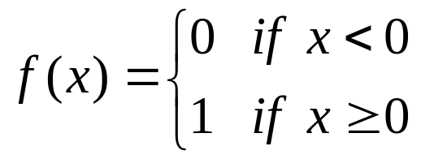
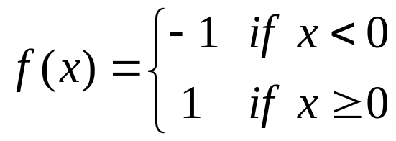
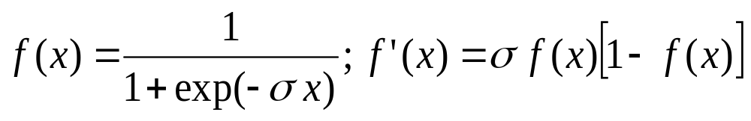
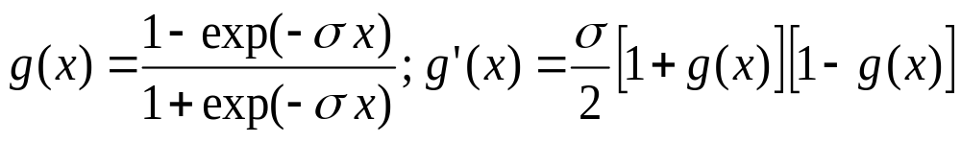
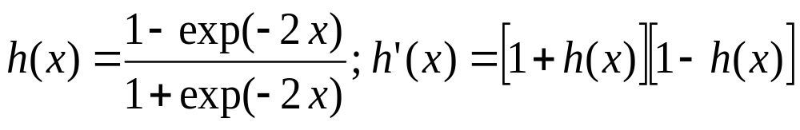
Common Activation Functions
1. Binary Step Function
(a “threshold” or “Heaviside” function)
2. Bipolar Step Function
3. Binary Sigmoid Function
(Logistic Sigmoid)
3. Bipolar Sigmoid
4. Hyperbolic -
Tangent

Slide 33
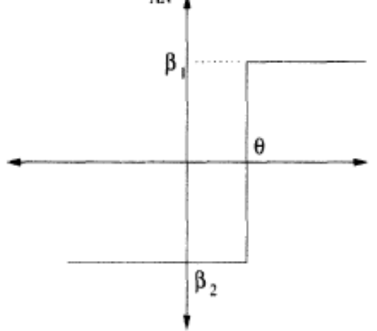
ARTIFICIAL NEURAL NETWORKS
Activation Functions
Step Function
y = f(act) = β₁ If act ≥ 0
= β₂ If act < 0
For the step function only
one of the two scalar values
are possible at the output
Usually (β₁, β₂) are taken as (1, -1) or (1, 0)

Slide 34
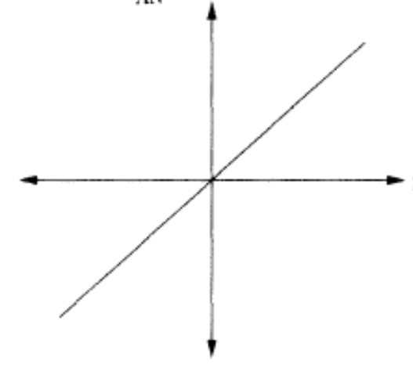
ARTIFICIAL NEURAL NETWORKS
Activation Functions
Linear Function
y = f(act) = γ * act
The neuron output is simply equal to the weighted sum of the inputs. It may be modulated by a constant factor γ
Decision Boundary: This is not suitable for neurons used for classification purposes

Slide 35
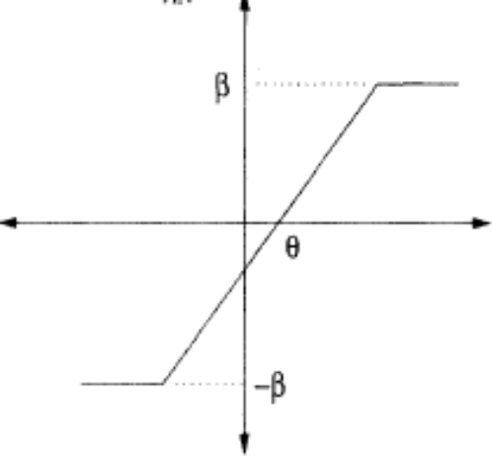
ARTIFICIAL NEURAL NETWORKS
Activation Functions
Ramp Function
y = f(act) = β If act ≥ β
= act If -β < act < β
= -β If act ≤ -β
It is a combination of the linear and step functions

Slide 36
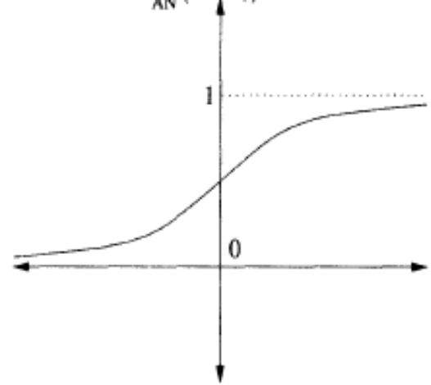
ARTIFICIAL NEURAL NETWORKS
Activation Functions
Sigmoid Function (Logistic function)
y = f(act) = 1
1 + e^{– λ(act)}
The sigmoid function is a continuous version of the ramp function
The parameter λ controls the steepness of the function. Large λ makes it almost a unit step function.
Usually λ = 1

Slide 37
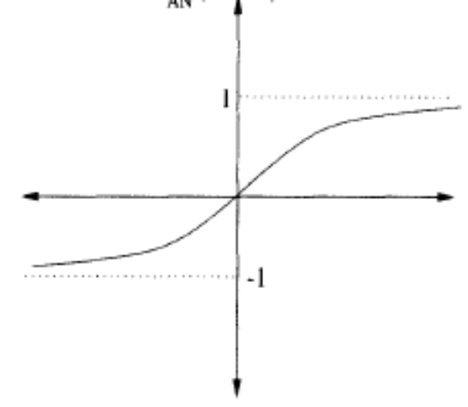
ARTIFICIAL NEURAL NETWORKS
Activation Functions
Hyperbolic Tangent Function
y = f(act) = e^{λ(act)} - e^{– λ(act)}
e^{λ(act)} + e^{– λ(act)}
= 2 - 1
1 + e^{– λ(act)}
The output of this function is in the range (-1, 1)

Slide 38
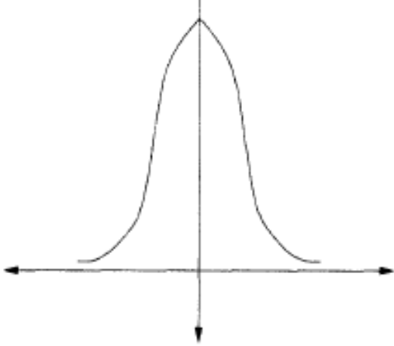
ARTIFICIAL NEURAL NETWORKS
Activation Functions
Gaussian Function
y = f(act) = e^{-θ}
where θ = (act)²/σ²
Where σ² is the variance of the Gaussian distribution

Slide 39

NEURAL NETWORKS
Multi Layer Perceptron: Activation functions

Slide 40
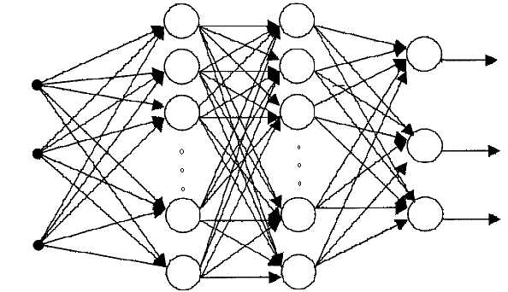
NEURAL NETWORKS
Multi Layer Perceptron: Architecture & Forward Pass
Input Units Hidden Units Output Units

Slide 41
NEURAL NETWORKS
Backpropagation Algorithm
Set up the architecture & initialize the weights of the network
Apply the training pairs (input-output vectors) from the training set, one by one
For each training pair, calculate the output of the network
Calculate the error between actual output & desired output
Propagate the error backwards & adjust the weights in such a way that minimizes the error
Repeat the above steps for each pair in the training set until the error for the set is lower than the required minimum error

Slide 42
NEURAL NETWORKS
Multi Layer Perceptron:
Training by Backpropagation Algorithm
Let E = accumulative error over a data set. It is a function of network weights
E = ∑_{training samples}∑_{j} (d_{j} – O_{j})²
d_{j} is the desired output of node j and O_{j} is the actual output
The error is squared so that the positive and negative errors may not cancel each other out during summation

Slide 43
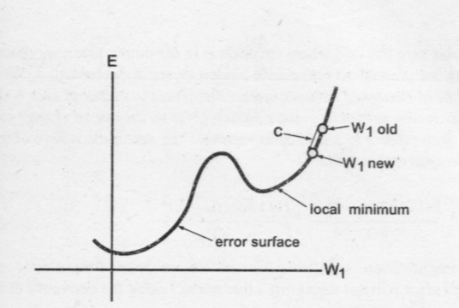
NEURAL NETWORKS
Multi Layer Perceptron:
Training by Backpropagation Algorithm
Each weight configuration can be represented by a point on an error surface

Slide 44
NEURAL NETWORKS
Multi Layer Perceptron: Training
Starting from a random weight configuration, we want our training algorithm to move in the direction where error is reduced more rapidly
Delta rule attempts to minimize the local error and uses the derivative of the error to find the slope of the error space in the region local to a particular point

Slide 45
NEURAL NETWORKS
Multi Layer Perceptron: Training
Delta rule uses gradient descent:
Δw_{ij} = -c (∂Error/ ∂w_{ij})
Let current weight be 4
Then ∂Error/ ∂w_{ij} = 9.5 – 9.0/5 – 3 = 0.25
The new weight will be w_{new} = w_{old} –c*0.25 = 3.875
if c = 0.5 (c is the learning rate)
If the error curve had been downward, then
∂Error/ ∂w_{ij} = 9.0 – 9.5/5 – 3 = -0.25
The new weight will be
w_{new} = w_{old} –c*-0.25 = 4.125

Slide 46
NEURAL NETWORKS
Multi Layer Perceptron: Training
Delta rule:
Δw_{ij} = -c (∂Error/ ∂w_{ij})
If the learning constant “c” is large (more than 0.5), weights move quickly to optimal value but there is a risk of overshooting the minimum or oscillation around optimum weights
If “c” is small, the training is less prone to these problems but system does not learn quickly; also the algorithm may get stuck in local minima

Slide 47
NEURAL NETWORKS
Multi Layer Perceptron: Training
The weights are updated incrementally, following the presentation of each training example
This corresponds to a stochastic approximation to gradient descent
To obtain the true gradient of Error, one would consider all of the training examples before altering the weight values
The stochastic approximation avoids costly computations per weight update

Slide 48
NEURAL NETWORKS
Multi Layer Perceptron: Training of Output Layer Weights
Randomly set the weights
Present first training input vector to the network
Calculate the outputs of all neurons
The inputs to the last layer of neurons would be the output of 2nd last layer
We calculate the Error of all the output neurons and now we wish to change the weights of an output neuron “j” so that its error reduces
We use Delta rule:
Δw_{ij} = -c (∂Error/ ∂w_{ij})

Slide 49
NEURAL NETWORKS
Multi Layer Perceptron: Training of Output Layer Weights
The equation ∂Error/ ∂w_{ij} means that we want the rate of change of network error as a function of the change in one of weights of an output node j
Since for our current training sample
Error = ∑_{j} (d_{j} - O_{j})²
Where O_{j} is itself a function of other variables (including w_{ij}), therefore we use partial derivatives (they gives us the rate of change of a multi-variable function w.r.t a particular variable)

Slide 50
NEURAL NETWORKS
Multi Layer Perceptron: Training of Output Layer Weights
To calculate this quantity we use chain rule
The Error is only indirectly dependent on w_{ij}, but it is directly dependent on variable O_{j}
∂Error/ ∂w_{ij} = (∂Error/ ∂O_{j}) . (∂ O_{j} / ∂w_{ij})
∂Error/ ∂O_{j} = rate of change of error w.r.t output of node j
Now ∂Error/ ∂O_{j} = ∑_{j} (d_{j} - O_{j})² /∂O_{j} = -2(d_{j} - O_{j})
For ∂ O_{j} / ∂w_{ij} we have (∂ O_{j} / ∂act_{j}) (∂ act_{j} / ∂w_{ij})
(∂ O_{j} / ∂act_{j}) = (∂ f(act)_{j} / ∂act_{j}) = f’(act_{j})
(∂ act_{j} / ∂w_{ij}) = (∂ ∑_{i} x_{i}w_{ij}/ ∂w_{ij}) = x_{i}
Hence Δw_{ij} = -c (∂Error/ ∂w_{ij}) = -c[-2(d_{j} - O_{j}) . f’(act_{j}) . x_{i}]

Slide 51
NEURAL NETWORKS
Multi Layer Perceptron: Training of Hidden Layer Weights
The formula for hidden layer weights update is different
because
the training examples provide target values only for the network outputs, and no target values are directly available to indicate the error of hidden unit’s values

Slide 52
NEURAL NETWORKS
Multi Layer Perceptron: Training of Hidden Layer Weights
j
w_{ki}
k
i
Hidden layer
Output layer

Slide 53
NEURAL NETWORKS
Multi Layer Perceptron: Training of Hidden Layer Weights
Adjustment of k^{th} weight of node “i”
Δw_{ki} = -c (∂Error/ ∂w_{ki})
Since Error is not a direct function of weight w_{ki}, therefore we use chain rule
∂Error/ ∂w_{ki} = (∂Error/ ∂O_{i}) . (∂ O_{i} / ∂w_{ki})
∂Error/ ∂O_{i} = rate of change of error w.r.t output of node i
= ∂ ∑_{j} Error_{j}/ ∂O_{i}
k
w_{ki}
i

Slide 54
NEURAL NETWORKS
Multi Layer Perceptron: Training of Hidden Layer Weights
Since each Error_{j} is independent
of other Error_{j}
(each has its own independent weight set)
Hence
∂ ∑_{j} Error_{j}/ ∂O_{i} = ∑_{j} (∂ Error_{j}/ ∂O_{i} )
Again use chain rule we have
= ∑_{j} [(∂ Error_{j}/ ∂act_{j}) . (∂act_{j} / ∂O_{i})]
k
w_{ki}
i

Slide 55
NEURAL NETWORKS
Multi Layer Perceptron: Training of Hidden Layer Weights
∂ ∑_{j} Error_{j}/ ∂O_{i} = ∑_{j} [(∂ Error_{j}/ ∂act_{j}) . (∂act_{j} / ∂O_{i})]
∂ Error_{j}/ ∂act_{j} = (∂ Error_{j}/ ∂O_{j}) (∂ O_{j}/ ∂act_{j})
where ∂ Error_{j}/ ∂O_{j} = ∂ (d_{j} – O_{j})²/ ∂O_{j} = -2(d_{j} - O_{j})
and ∂ O_{j}/ ∂act_{j} = ∂ f(act_{j})/ ∂act_{j} = f’(act_{j})
(∂act_{j} / ∂O_{i}) = (∂ ∑ x_{i}w_{ij} / ∂O_{i})
Since O_{i} = x_{i}
hence ∂act_{j} / ∂O_{i} = w_{ij}

Slide 56
NEURAL NETWORKS
Multi Layer Perceptron: Training of Hidden Layer Weights
So we started with
∂Error/ ∂w_{ki} = (∂Error/ ∂O_{i}) . (∂ O_{i} / ∂w_{ki})
and we have determined the first part
For the 2nd part
∂ O_{i} / ∂w_{ki} = (∂ O_{i} / ∂act_{i})(∂ act_{i} / ∂w_{ki})
(∂ act_{i} / ∂w_{ki}) = (∂ ∑_{k} x_{k}w_{ki}/ ∂w_{ki}) = x_{k}
(∂ O_{i} / ∂act_{i}) = (∂ f(act)_{i} / ∂act_{i}) = f’(act)_{i}
Hence Δw_{ki} = -c (∂Error/ ∂w_{ki})
= -c[-2∑_{j} {(d_{j} - O_{j}) f’(act_{j}) w_{ij} }f’(act)_{i} x_{k}]
k
w_{ki}
i

Slide 57
NEURAL NETWORKS
For Output Layer:
Hence Δw_{ij} = -c (∂Error/ ∂w_{ij}) = -c[-2(d_{j} - O_{j}) . f’(act_{j}) . x_{i}]
For Hidden Layer:
Hence Δw_{ki} = -c (∂Error/ ∂w_{ki})
= -c[-2∑_{j} {(d_{j} - O_{j}) f’(act_{j}) w_{ij} }f’(act)_{i} x_{k}]

Slide 58
NEURAL NETWORKS
Multi Layer Perceptron: Training
A typical activation function is logistic function (which is a type of sigmoidal function)
f(act) = 1/(1 + e^{-λact})
If value of λ (squashing parameter) is large we have a unit step function, if it is small we have almost a straight line between two saturation limits
f’(act) = f(act)(1 – f(act))

Slide 59
NEURAL NETWORKS
Multi Layer Perceptron: Training
This approach is called “gradient descent learning”
Requirement of this approach is that the activation function must be differentiable (i.e. continuous)
The number of input and output neurons are fixed
But the selection of number of hidden layers and the number of neurons in the hidden layers is done by trial and error

Slide 60
NEURAL NETWORKS
Multi Layer Perceptron: Training
The gradient descent is not guaranteed to converge to the global optimum
The algorithm we have discussed is the incremental gradient descent (or stochastic gradient descent) version of the Backpropagation

Slide 61
NEURAL NETWORKS
Multi Layer Perceptron: Face Recognition Example
Images of 20 different people
32 images per person
With varying expressions (happy, sad, angry, neutral)
and
looking in various directions (left, right, straight, up)
and
with and without sunglasses
Grayscale images (intensity between 0 to 255) and
size (resolution) of 120 x 128 pixels

Slide 62
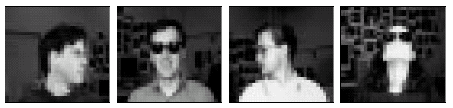

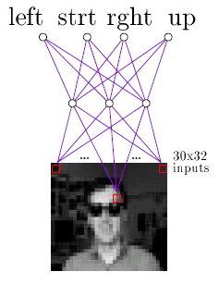
NEURAL NETWORKS
Multi Layer Perceptron: Face Recognition Example

Slide 63
NEURAL NETWORKS
Multi Layer Perceptron: Face Recognition Example
An ANN can be trained on any one of a variety of target functions using this image data, e.g.
- identity of a person
- direction in which person is looking
- whether or not they are wearing sunglasses

Slide 64
NEURAL NETWORKS
Multi Layer Perceptron: Face Recognition Example
Design Choices:
Separate the data into
training (260 images) and test sets (364 images)
Input Encoding
- 30 x 32 pixel image
- A coarse resolution of the 120 x 128 pixel image
- Every 4 x 4 pixels are replaced by their mean value
- The pixel intensity is linearly scaled from 0 to 1 so that inputs, hidden units and output units have the same range

Slide 65
NEURAL NETWORKS
Multi Layer Perceptron: Face Recognition Example
Design Choices:
Output Encoding
- Learning Task: Direction in which person is looking
- Only one neuron could have been used with outputs
0.2, 0.4, 0.6, and 0.8 to encode the four possible values
- But we use 4 output neurons, so that measure of confidence in the ANN’s decision can be obtained
- Output vector:
1 for true & 0 for false; e.g. [1, 0, 0, 0]

Slide 66
NEURAL NETWORKS
Multi Layer Perceptron: Face Recognition Example
Design Choices:
Network Structure
- How many Layers?
Usually one hidden layer is enough
- How many units in the hidden layer
More than necessary units result in over-fitting
Less units result in failure of training
Trial & error: Start with a number and prune the units with the help of a cross-validation set

Slide 67
Reading Assignment & References
1. Section 10.1.1, 10.2.1 and 10.2.2
from George F. Luger
2. Machine Learning by Tom Mitchell
http://www-2.cs.cmu.edu/afs/cs/project/ai-repository/
ai/areas/neural/systems/nevprop/np.c

